Slide 1
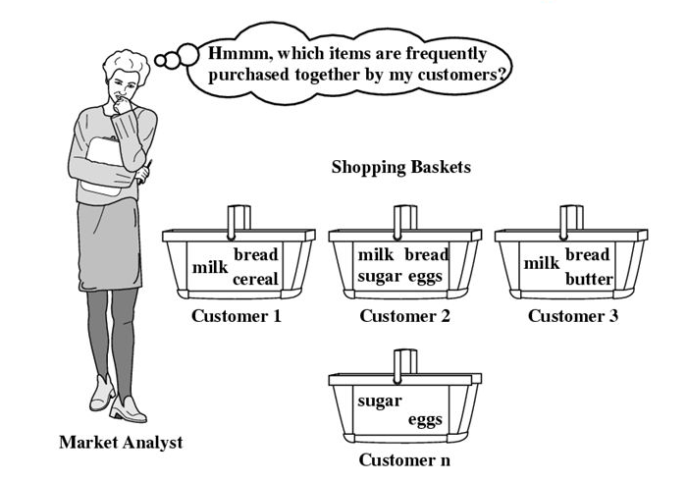



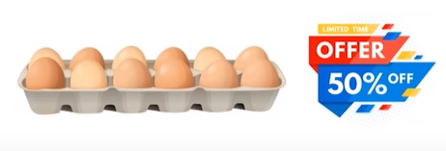
Background :
Considering a retail store,
Goal : Increase revenue by pitching one or more product with other products
How : Uncover association between frequently bought items under a set of transactions
Benefit :
Product Placement
Promotional Pricing
Use
Association
Rule
Background

Slide 2
Association Rule :
Rule-based machine learning method for discovering interesting relations between variables in large databases using some measures of interestingness.
Works on If – Then relationship between variables
Background
Association Rule

Slide 3
Association Rule :
Rule-based machine learning method for discovering interesting relations between variables in large databases using some measures of interestingness.
Works on If – Then relationship between variables
{A} -> {B}
{A,B} -> {C}
If - Antecedent
Then - Consequent
If - Antecedent
Then - Consequent
Background
Association Rule

Slide 4
Association Rule :
Rule-based machine learning method for discovering interesting relations between variables in large databases using some measures of interestingness.
Works on If – Then relationship between variables
{A} -> {B}
{A,B} -> {C}
Trans ID | Items
151 | Veggies, Spaghetti, Chicken
152 | Spaghetti, Ketchup, Veggies
153 | Eggs, Bread, Sausage, Milk
154 | Coke, Bread, Milk, Eggs
155 | Cheese, Eggs, Milk
156 | Ice Cream, Brownie
If - Antecedent
Then - Consequent
If - Antecedent
Then - Consequent
Example
{Brownie} -> {Ice Cream}
Antecedent : Brownie
Consequent : Ice Cream
If a customer buys Brownie he/she is likely to buy
Ice cream
Background
Association Rule

Slide 5
Association Rule :
Rule-based machine learning method for discovering interesting relations between variables in large databases using some measures of interestingness.
Works on If – Then relationship between variables
{A} -> {B}
{A,B} -> {C}
Trans ID | Items
151 | Veggies, Spaghetti, Chicken
152 | Spaghetti, Ketchup, Veggies
153 | Eggs, Bread, Sausage, Milk
154 | Coke, Bread, Milk, Eggs
155 | Cheese, Eggs, Milk
156 | Ice Cream, Brownie
If - Antecedent
Then - Consequent
If - Antecedent
Then - Consequent
Example
{Brownie} -> {Ice Cream}
Antecedent : Brownie
Consequent : Ice Cream
If a customer buys Brownie he/she is likely to buy
Ice cream
Background
Association Rule

Slide 6
Association Rule :
Definitions:
Item set: Collection of items to one or more items
Eggs
Bread
Item set = {Eggs, Bread}
Trans ID | Items
151 | Veggies, Spaghetti, Chicken
152 | Spaghetti, Ketchup, Veggies
153 | Eggs, Bread, Sausage, Milk
154 | Coke, Bread, Milk, Eggs
155 | Cheese, Eggs, Milk
156 | Ice Cream, Brownie
Background
Association Rule

Slide 7
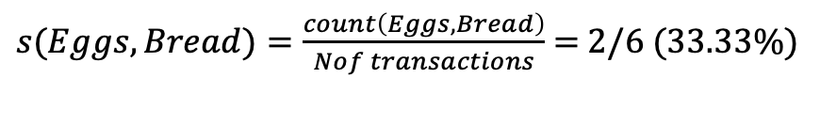
Association Rule :
Definitions:
Item set: Collection of items to one or more items
Eggs
Bread
Item set = {Eggs, Bread}
Trans ID | Items
151 | Veggies, Spaghetti, Chicken
152 | Spaghetti, Ketchup, Veggies
153 | Eggs, Bread, Sausage, Milk
154 | Coke, Bread, Milk, Eggs
155 | Cheese, Eggs, Milk
156 | Ice Cream, Brownie
Support (s): Gives an idea of how frequent an itemset is in all the transactions. A high value means that the items involves a great part of database.
$s(Eggs, Bread)=\frac{count\left(Eggs, Bread\right)}{Nof transactions}$ = 2/6 (33.33%)
No Bread
Background
Association Rule

Slide 8
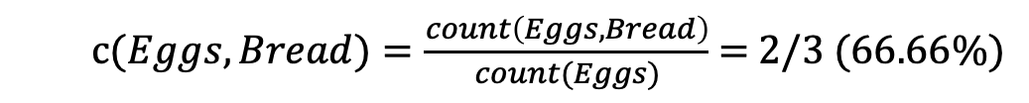
Association Rule :
Definitions:
Item set: Collection of items to one or more items
Eggs
Bread
Item set = {Eggs, Bread}
Trans ID | Items
151 | Veggies, Spaghetti, Chicken
152 | Spaghetti, Ketchup, Veggies
153 | Eggs, Bread, Sausage, Milk
154 | Coke, Bread, Milk, Eggs
155 | Cheese, Eggs, Milk
156 | Ice Cream, Brownie
Support (s): Gives an idea of how frequent an itemset is in all the transactions. A high value means that the items involves a great part of database.
$s(Eggs, Bread)=\frac{count\left(Eggs, Bread\right)}{Nof transactions}$ = 2/6 (33.33%)
Confidence (c): Measure of entries with consequent where antecedent appears in the transaction.
c$(Eggs, Bread)=\frac{count\left(Eggs, Bread\right)}{count(Eggs)}$ = 2/3 (66.66%)
Background
Association Rule

Slide 9
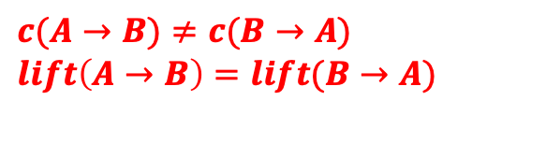
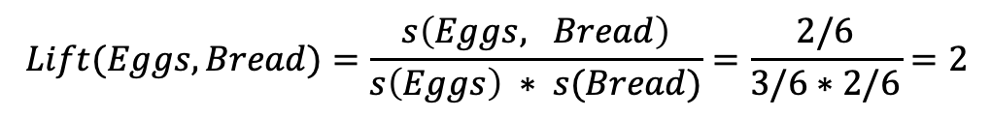
Association Rule :
Definitions:
Lift: Indicates whether there is a relationship between items, or whether the two items are occurring randomly
Eggs
Bread
Trans ID | Items
151 | Veggies, Spaghetti, Chicken
152 | Spaghetti, Ketchup, Veggies
153 | Eggs, Bread, Sausage, Milk
154 | Coke, Bread, Milk, Eggs
155 | Cheese, Eggs, Milk
156 | Ice Cream, Brownie
$$Lift(Eggs, Bread)=\frac{s\left(Eggs, Bread\right)}{s\left(Eggs\right) ∗ s(Bread)}=\frac{2/6}{3/6∗2/6}=2$$
lift = 1 implies no relationship between A and B
(ie: A and B occur together only by chance)
lift > 1 implies that there is a positive relationship
(ie: A and B occur together more often than random)
lift < 1 implies that there is a negative relationship
(ie: A and B occur together less often than random)
$c(A→B)≠c(B→A)$
$lift\left(A→B\right)=lift(B→A)$
Background
Association Rule

Slide 10
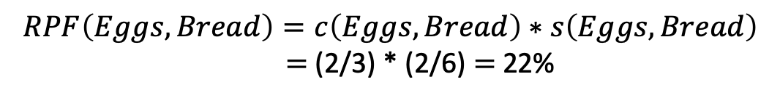
Association Rule :
Definitions:
Rule power factor: Rule Power Factor is an indication of how intense a rule's items are associated with each other in terms of positive relationship.
Eggs
Bread
Trans ID | Items
151 | Veggies, Spaghetti, Chicken
152 | Spaghetti, Ketchup, Veggies
153 | Eggs, Bread, Sausage, Milk
154 | Coke, Bread, Milk, Eggs
155 | Cheese, Eggs, Milk
156 | Ice Cream, Brownie
$$RPF\left(Eggs, Bread\right)=c\left(Eggs,Bread\right)∗s\left(Eggs,Bread\right)$$
$=$(2/3) * (2/6) $=$ 22%
Example: For N=100
s(A)=0.2, s(B)=0.5,
s(A,B)=0.15
RPF??
c(A,B)??
0.15/0.2=75%
0.75*0.15=0.11
s(A)=0.3, s(B)=0.6
s(A,B)=0.20
0.2/0.3=66%
0.66*0.2=0.13
Background
Association Rule

Slide 11
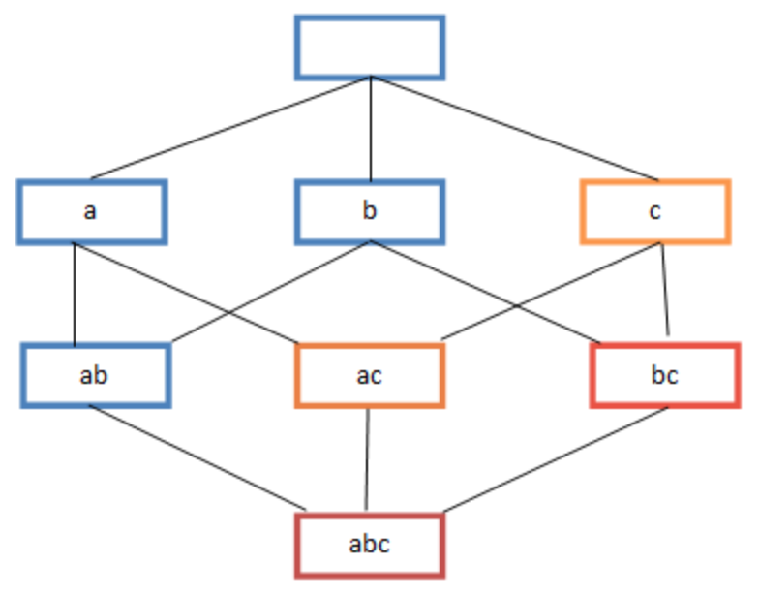
Association Rule :
For ‘n’ unique items 2^{n} -1 itemset can be obtained (Excluding the empty item set). Analyzing all sets is computationally expensive
Hence, we set required (minimum) support and confidence threshold and perform model on those item sets only
Rule generation: Grouping itemset with if-then condition with
(support > min support) & (confidence > min confidence)
Background
Association Rule

Slide 12
Association Rule :
Some prominent rule generating Algorithms are:
Apriori algorithm
Uses a breadth-first search strategy to count the support of item sets and uses a candidate generation function which exploits the downward closure property of support.
Eclat algorithm
Equivalence Class Transformation is a depth-first search algorithm based on set intersection. It is suitable for both sequential as well as parallel execution with locality-enhancing properties
Context Based Association Rule Mining Algorithm
CBPNARM is an algorithm, to mine association rules on the basis of context. It uses context variable on the basis of which the support of an itemset is changed on the basis of which the rules are finally populated to the rule set.
Background
Association Rule

Slide 13
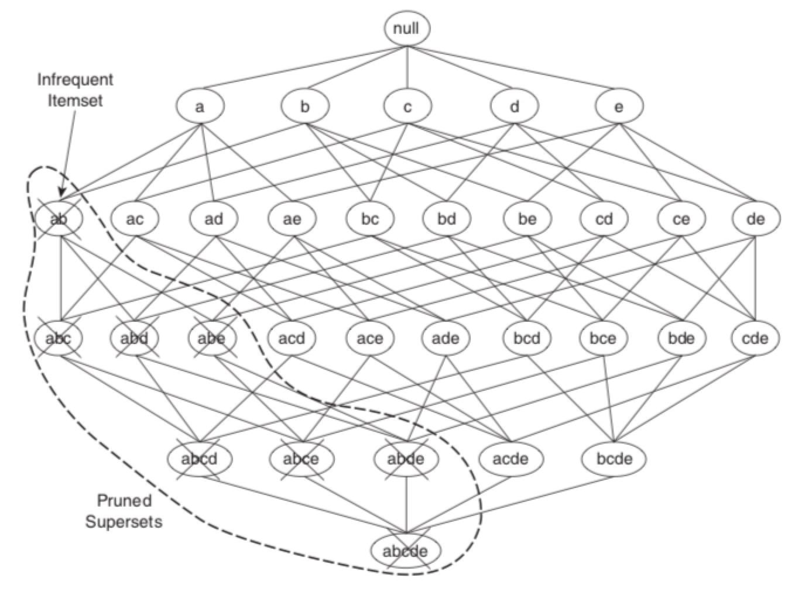
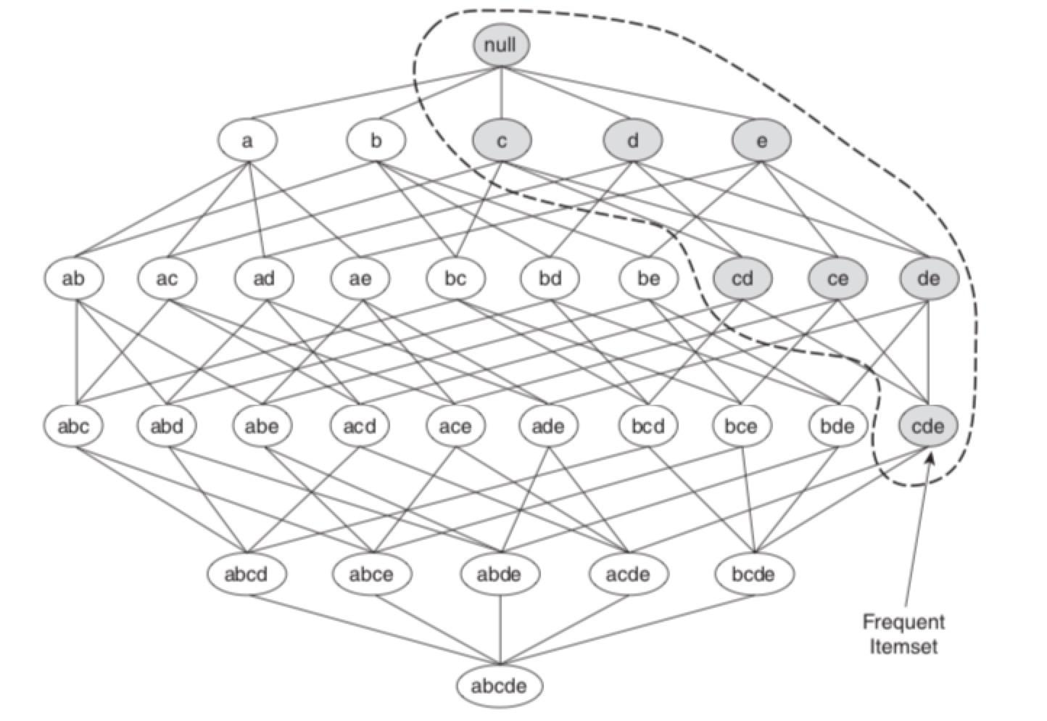
Apriori Algorithm:
Any subset of a frequent itemset must be frequent
Supersets of infrequent itemset must also be infrequent
A transaction containing {eggs, milk, bread} also contains {bread, milk}
If {Eggs, Milk, Bread} is frequent → {Egg, Milk} must also be frequent
Background
Association Rule
Apriori Algorithm

Slide 14
Apriori Algorithm:
Breadth-first search strategy to count the support of item sets
A candidate generation function exploits the downward closure property of support.
For k products
User sets a minimum support criterion
Algorithm generates a list of one-item sets that meet the support criterion
Use this list of one-item sets to generate list of two-item sets that meet the support criterion
Use list of two-item sets to generate list of three-item sets
Continue up through k-item sets
Background
Association Rule
Apriori Algorithm

Slide 15
Example: User input -> min support=2
Itemset | Support
Veggies | 2
Spaghetti | 2
Chicken | 1
Ketchup | 1
Eggs | 3
Bread | 2
Sausage | 1
Milk | 3
Coke | 1
Cheese | 1
Ice Cream | 1
Brownie | 1
Trans ID | Items
151 | Veggies, Spaghetti, Chicken
152 | Spaghetti, Ketchup, Veggies
153 | Eggs, Bread, Sausage, Milk
154 | Coke, Bread, Milk, Eggs
155 | Cheese, Eggs, Milk
156 | Ice Cream, Brownie
Background
Association Rule
Apriori Algorithm

Slide 16
Example: User input -> min support=2
Itemset | Support
Veggies | 2
Spaghetti | 2
Chicken | 1
Ketchup | 1
Eggs | 3
Bread | 2
Sausage | 1
Milk | 3
Coke | 1
Cheese | 1
Ice Cream | 1
Brownie | 1
Itemset | Support
Veggies, Spaghetti | 1
Veggies, Eggs | 0
Veggies, Bread | 0
Veggies, Milk | 0
Spaghetti, Eggs | 0
Spaghetti, Bread | 0
Spaghetti, Milk | 0
Eggs, Bread | 2
Eggs, Milk | 3
Bread, Milk | 2
Trans ID | Items
151 | Veggies, Spaghetti, Chicken
152 | Spaghetti, Ketchup, Veggies
153 | Eggs, Bread, Sausage, Milk
154 | Coke, Bread, Milk, Eggs
155 | Cheese, Eggs, Milk
156 | Ice Cream, Brownie
Background
Association Rule
Apriori Algorithm

Slide 17
Example: User input -> min support=2
Itemset | Support
Veggies | 2
Spaghetti | 2
Chicken | 1
Ketchup | 1
Eggs | 3
Bread | 2
Sausage | 1
Milk | 3
Coke | 1
Cheese | 1
Ice Cream | 1
Brownie | 1
Itemset | Support
Veggies, Spaghetti | 1
Veggies, Eggs | 0
Veggies, Bread | 0
Veggies, Milk | 0
Spaghetti, Eggs | 0
Spaghetti, Bread | 0
Spaghetti, Milk | 0
Eggs, Bread | 2
Eggs, Milk | 3
Bread, Milk | 2
Itemset | Support
Eggs, Bread, Milk | 2
Trans ID | Items
151 | Veggies, Spaghetti, Chicken
152 | Spaghetti, Ketchup, Veggies
153 | Eggs, Bread, Sausage, Milk
154 | Coke, Bread, Milk, Eggs
155 | Cheese, Eggs, Milk
156 | Ice Cream, Brownie
Background
Association Rule
Apriori Algorithm

Slide 18
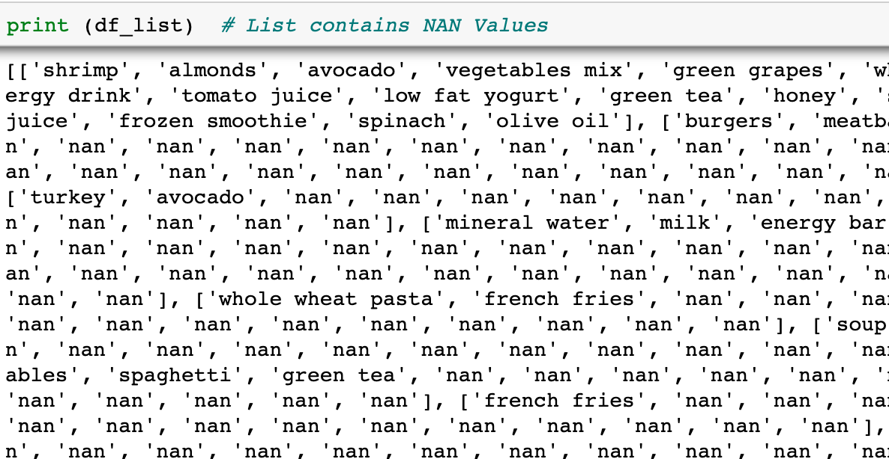
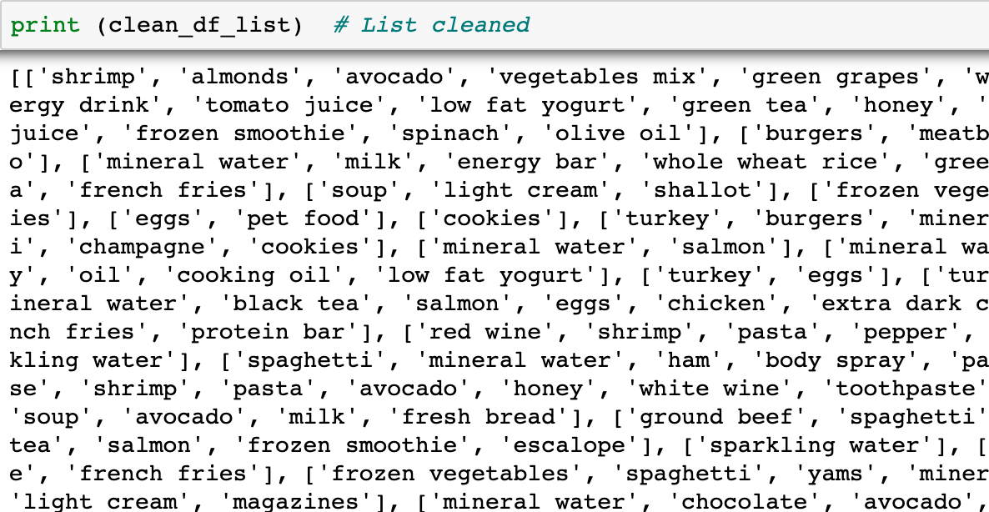
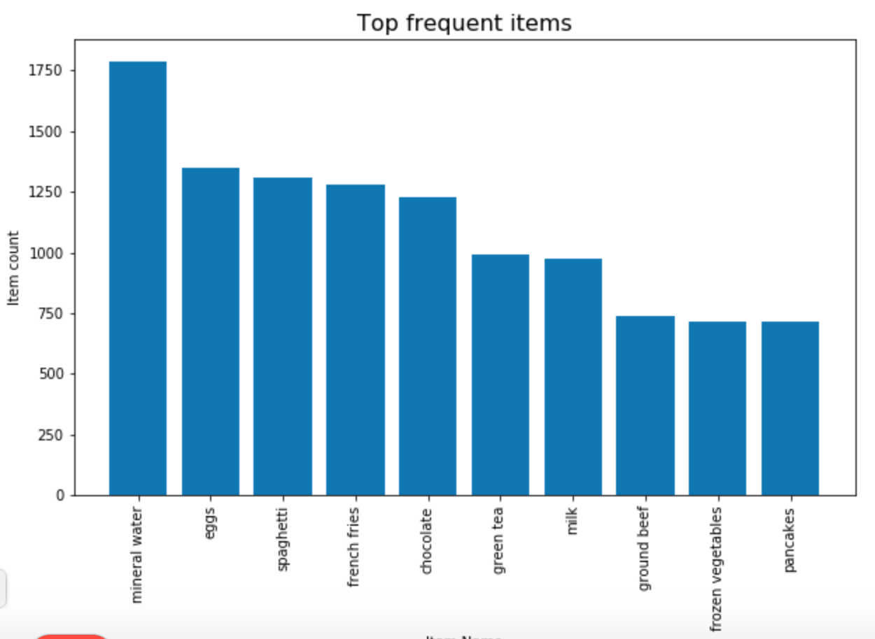
Modelling :
Gather transaction data
Cleaning the data
Background
Association Rule
Apriori Algorithm
Modelling (Python)

Slide 19
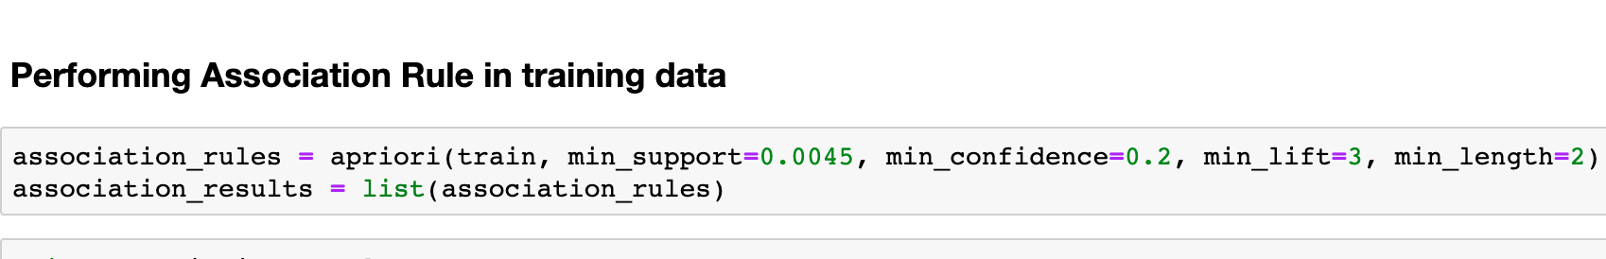
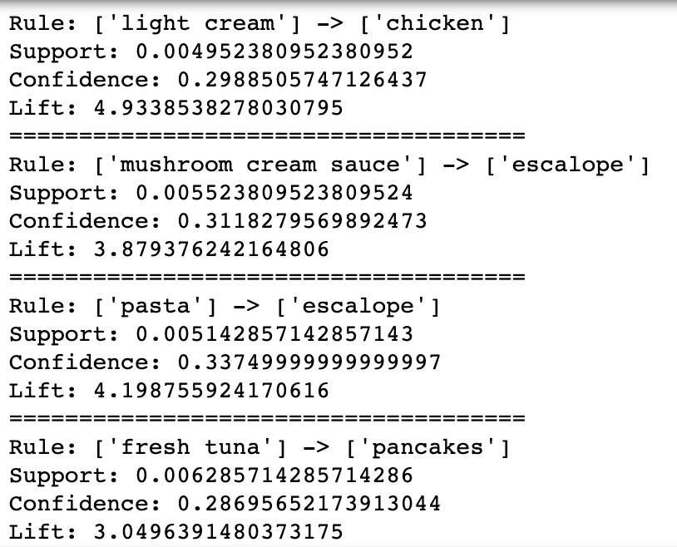
Generated Rules
How to select
min_support, min_confidence??
Background
Association Rule
Apriori Algorithm
Modelling (Python)

Slide 20
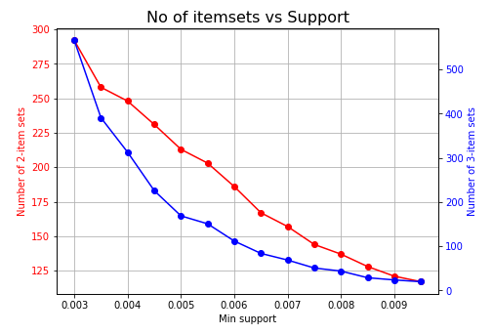
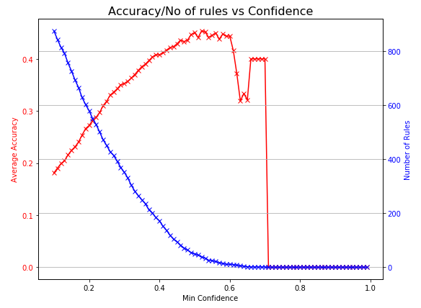
The number of item sets decrease with increase in support value. Therefore, to have optimum transactions to check for confidence, we will choose the least value of support
There is a trade-off between model accuracy and number of rules, at different min_confidence values.
Background
Association Rule
Apriori Algorithm
Modelling (Python)

Slide 21
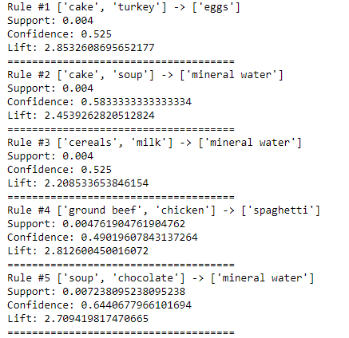
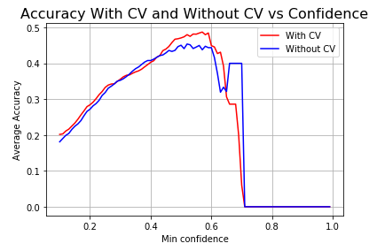
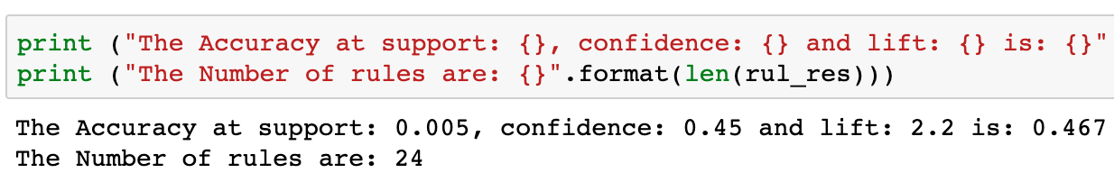
Results:
Top 5 rules after parameter tuning
Background
Association Rule
Apriori Algorithm
Modelling (Python)
Results

Slide 22
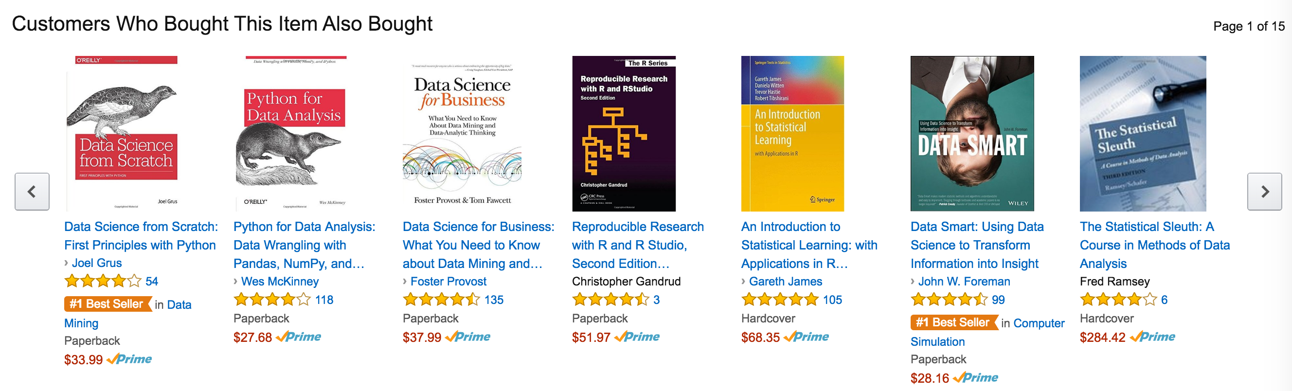
Applications:
Gain insight about merchandise (FMCG)
Which products are brought together
Products to be offered promotions
Designing store layouts, etc.,
Unusual combinations of insurance can be a sign of fraud and can spark further investigation.
Medical patient histories can give indications of likely complications based on certain combinations of treatments.
Plagiarism check of various documents.
Suggestions on related searches (Google, Facebook ads)
Background
Association Rule
Apriori Algorithm
Modelling (Python)
Results
Applications

